Slide 1

Dublin Core Application Profiles at the British Library
DC 2005 - University Carlos III, Madrid
13 September 2005
Robina Clayphan, Bill Oldroyd
The British Library
Notes:
I would like to talk to you briefly about how the BL is using DC application profiles to tackle one aspect of resource discovery. The greater part of this presentation will be used by my colleague and co-author Bill Oldroyd to demonstrate using the British Library Application profile in a cross-searching diverse databases.

Slide 2
Introduction
The British Library (BL) now successfully operates as a single large organisation
  But it has evolved from many smaller, specialist entities
It has an inheritance of many different legacy systems and bibliographic formats which support services designed for specific user groups
Added to this mix are the various metadata outputs of more recent digitisation activities
  started before interoperability was a major concern for digital information
A need for a mechanism to control further proliferation and achieve a degree of harmonisation amongst the existing ones.
Notes:
The BL is a single, large organisation but it has evolved into this over several decades from many smaller and often specialist entities.
The consequence of this is that it has an inheritance of many legacy systems and many differing bibliographic formats which had developed to support services designed for specific user groups.
Added to this mix are the various metadata outputs of more recent digitisation activities many of which started before interoperability became a a major concern for digital information.
There was clearly a need for a mechanism to control further proliferation and bring a degree of harmonisation amongst the existing

Slide 3
Digitisation Projects
Large-scale digitisation of resources
  No existing catalogue records
  Not possible to route through normal MARC cataloguing channels
  Often have some external funding and are in collaboration with non-library partners
Typically, develop customised metadata formats to fit
  the aims and constraints of the project
  Material type, timescales, budgets, available expertise
Self-contained content management systems
  A link from the BL web pages
Not searchable in conjunction with other BL resources
Interoperability difficulties internally and externally
Notes:
Looking at the digitisation projects:
For some years now the BL has been undertaking digitisation of selections of its resources – often on quite a large scale
More often than not these resources do not have existing catalogue records (not in machine readable form, or because the item is only a part or detail of another larger resource).
Time and resources do not allow the routing of all these items through normal MARC cataloguing channels and
MARC is probably not the best choice in any case especially if there is external funding and collaboration with non-library partners.
Typically, there was and still is a tendency for these project to invent their own metadata format to get a good fit with the particular aims and constraints of the project. Principal factors being the material type, time and budget and the available expertise to create the records.
Also typically, these projects will buy their own content management system and produce a self contained system containing the metadata and digitised objects. They will have a link from the BL web page
While this process produces a nicely defined set of resources it also means that they will not be searchable in conjunction with other BL resources - for example, from a search of the main catalogue, large parts of the BLs digital collection are invisible.
It also means it would be difficult to harvest the metadata to share it internally or externally without developing and maintaining a mapping for each format. And an ever - expanding set of metadata formats to try and maintain and inter-relate.

Slide 4
Resource Discovery Strategy
Resource discovery strategy evolving alongside the definition of the underlying architecture
Some principles already articulated:
  Where metadata is being created outside the main BL systems .. must be be capable of exporting a file of coherent descriptive records in a format conforming to one of the supported BL standards. The minimum requirement is to supply records in the B-LAP encoded in XML .
Recognition that a range of metadata formats will continue to exist
  these must be limited in number
  Must be interoperable at some level
Notes:
A resource discovery strategy is evolving alongside the definition of the underlying architecture. That architecture will no doubt include portal functionality of some type and this will need to be able to read the metadata associated with the different resources. To simplify this task there is a need to control the proliferation of new metadata sets.
So although the strategy is not yet fully articulated, we do have one or two basic principles in place and this is one of them –
Where metadata is being created outside the main BL systems any content management systems or databases must be capable of generating and exporting a file of coherent descriptive records in a format conforming to one of the supported BL standards. The minimum requirement is to supply records in the BL AP encoded in XML .
The B-LAP is the British Library Application profile and is a DC based and I’ll expand on that in a moment.
So we are recognising that there is a range of metadata formats in common usage and they will continue to exist but –
To be manageable these must be limited in number
And at some level they must be interoperable – and we need to know how they relate to each other.

Slide 5
Development of BL Application Profile (B-LAP)
B-LAP – a listing of a common core of elements that have wide applicability across the library
  Based on DC-Lib, TEL and Collect Britain
  Four namespaces used DC, MODS, TEL and BL
  Some BL usage rules included
So far five initiatives have made use of it and declared individual APs based on the B-LAP
  Newspaper articles
  Journal and conference articles
  Sound
  Web pages
  Administrative
Notes:
The creation of B-LAP was an attempt to identfy and list a common core of elements that have wide applicability within the library.
It is Based on DC-Lib TEL and an early DC implementation at the BL – collect Britain
Four namespaces are used DC MODS TEL and, because we have coined some locally, we will have to establish a BL namespace as well.
We have added some BL usage rules as well
So far five initiatives have made use of it and declared individual profiles based uoon it.

Slide 6
Features of the profiles
Selection of a subset of terms from B-LAP
  depending on functions the metadata was needed to support
Additionally, each may have:
  added a few required terms from other namespaces e.g. eGMS (UK Government) “Category”
  coined a new term to be entered in the BL namespace e.g. PlaceOfPublication
The result is that each has an interoperable core of terms
Where a new term is found wider applicability it can be added to B-LAP e.g. DateReceipt
All are documented using CEN DCAP Guidelines
  www.cenorm.be/sh/mmi-dc
Notes:
Each started by considering the functions the metadata was needed to support and selected as many of the required terms from BLAP as possible – so each has used a subset of BLAP.
Each may have
Added terms for other namespaces – requirement of eGov that our pages have eGMS metadata
Coined a new term is absolutely necessary.
Interoperable core - Which are from the BL AP and can easily be transformed into qualified DC or dumbed right down to the DC 15.
Receipt date was needed in two applications so that will be added to the BL AP
In the absence of guidelines, creators of application profiles have invented a wide range of presentation formats which makes direct comparison difficult. These guidelines have examined 22 APs and distilled the salient features into a format that is as concise and simple as possible, yet as precise and detailed as is sometimes necessary to support their various uses. These guidelines have the modest aim of providing system developers and information specialists with a normalized and readable view of Dublin-Core-based metadata models
A DC AP is defined as …. is based in part on DC, follows DC grammatical principles, has a descriptive header, contains one or more term usages
There will be more information given on the BLAP the CEN guidelines in Tutorial 5 on Thursday.

Slide 7
Themed Collections
Major legacy systems outside the new ILS are increasingly difficult to maintain
  Migrate to MARC21 in ILS where possible
Customised datasets for specialist material
  Unlikely to fit with MARC21 due to e.g. contextual information
A system that can handle multiple different metadata formats and provide a common but customisable tool for data entry
Will use B-LAP to underpin a search based on core terms and link back to richer datasets
Notes:
The B-LAP also has a role in relation to the legacy systems which are currently outside the ILS in a system under development called “Themed Collections”.
As the BL moves onto newer platforms the major legacy systems are increasingly difficult to maintain. Where possible datasets will be migrated to MARC21 and loaded into the ILS – but this may not be possible in the near future (or at all) so the data will be loaded into “Themed Collections”
Similarly, with specialist datasets being created as a result of curatorial initiatives – it is unlikely that there will ever be a fit with MARC – for example due to the presence of large amounts of contextual information.
Themed Collections is intended to handle multiple metadata formats and hopes to offer a common but customisable data entry tool.
In this system B-LAP will be used to provide high level searching across all the datasets within it. By mapping the core elements to B-LAP a cross search can be achieved and once discovered, a user can be taken back to the richer underlying record.

Slide 8
Multiple metadata formats
Recognition that a range of metadata formats will continue to exist
Envisage formats on a spectrum from richer to simpler
Need to limit the number and make the relationships between them explicit using crosswalks
Select the format that satisfies a set of criteria
  based on functional requirements
Use of XML encoding to facilitate movement of metadataa up and down the spectrum according to the purpose to which the metadata is being put at any given point
Notes:
As I said earlier – we rcognise that a range of metadata formats wil continue to exist
They can be seen as lying along a spectrum from richer at one end to the most minimal at the other.
To control the data we need to limit the number of formats on that spectrum and use crosswalks to make the relationships between them explicit..
Project wanting to create metadata by whatever means should select the most appropriate format, guided by the functions the metadata is intended to support.
Envisage the use of XML encoding to facilitate the movement of the metadata up and down the spectrum according to the purpose to which it is being put at any given point.

Slide 9
Systems architecture
A tactical approach to using the profile
Exploitation of existing legacy systems using the new metadata profile
Allows experimentation without change to the infrastructure
Based on experience gained from participation in the European Library
Notes:
This section of our presentation describes how we created an architecture that lets the BL use the new metadata profile
If we were to wait until all the library’s varied catalogue and database systems were capable of using the profile we would never be able to exploit it. So we have taken a tactical approach to implementing the profile as widely as possible. This tactical architecture may not be the architecture we use for live operational systems, but it allows us to immediately experiment with the concept of a uniformaly applied application profile across a library’s databases.
The key aspect of the architecture has to allow us to use the data in existing systems, leaving these systems unchanged.
So having created an architecture we will be able to experiment with the use of the Application Profile.
Our approach to the architecture is based in BL’s involvement with the European Library

Slide 10
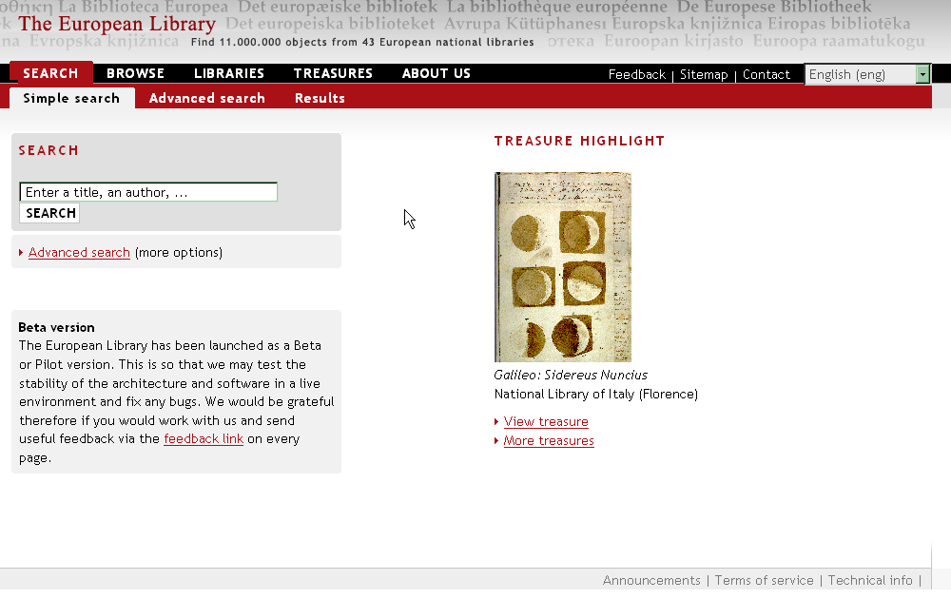
The European Library Portal
Notes:
The European Library is a portal, currently in Beta form, which allows a user access to the collections of National Libraries of Europe. Currently there are 12 partners and with the planned extension to 26 partners over the next 15 months.
Like any portal, the user enters a search, and the service performs that search across a selection of databases and catalogues.

Slide 11
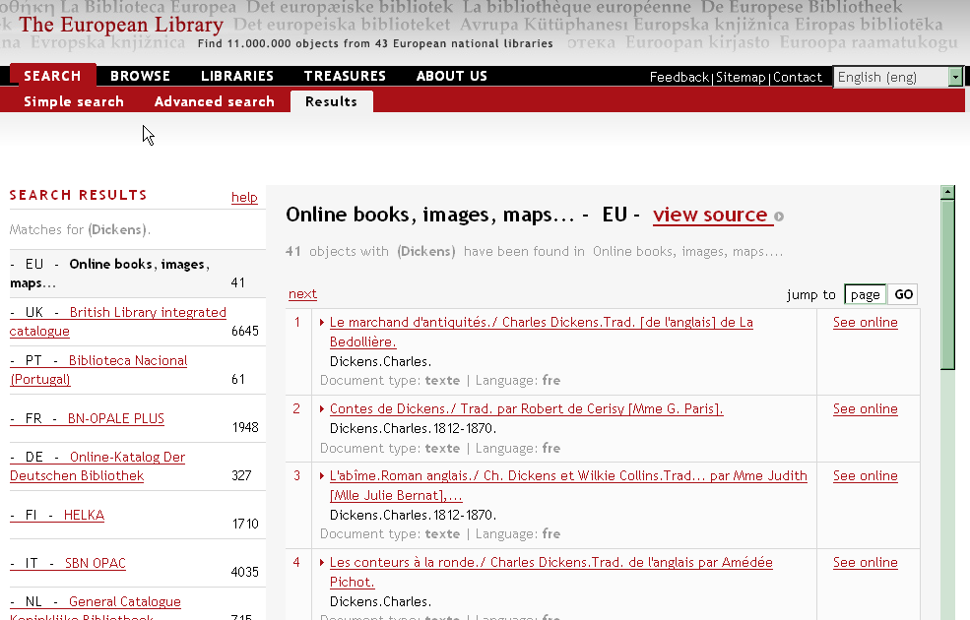
The search display showing on the left the hits against each
database and on the right a brief display of records from one database
Notes:
So the initial search is being made across the main catalogues of the partner libraries.
The progress and result of the search against each catalogue is shown in the left hand column, a brief list of results in the right hand column.

Slide 12
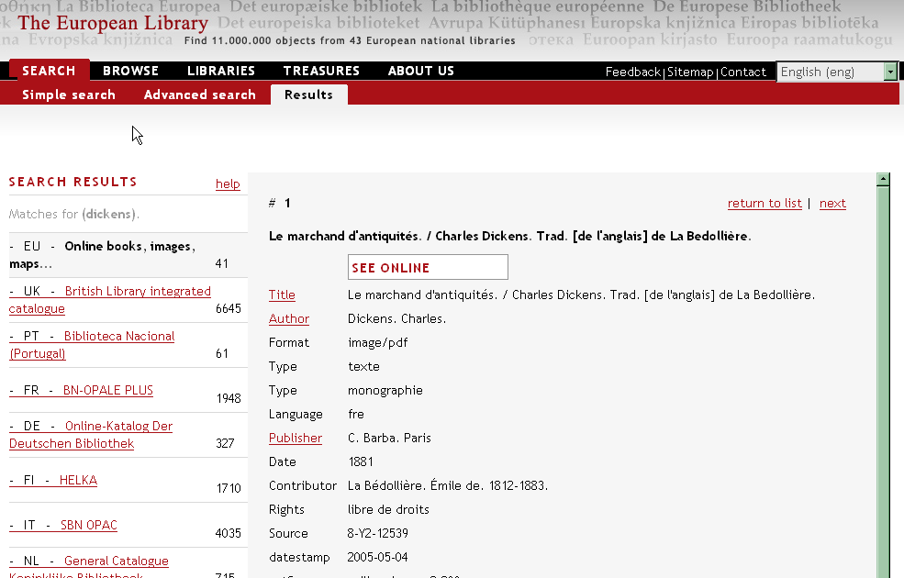
A full record display for one record, note the link to the online object
Notes:
Then a user can choose a brief entry and see the record in full.
Where possible the records contains links either to the on-line object and related services.

Slide 13
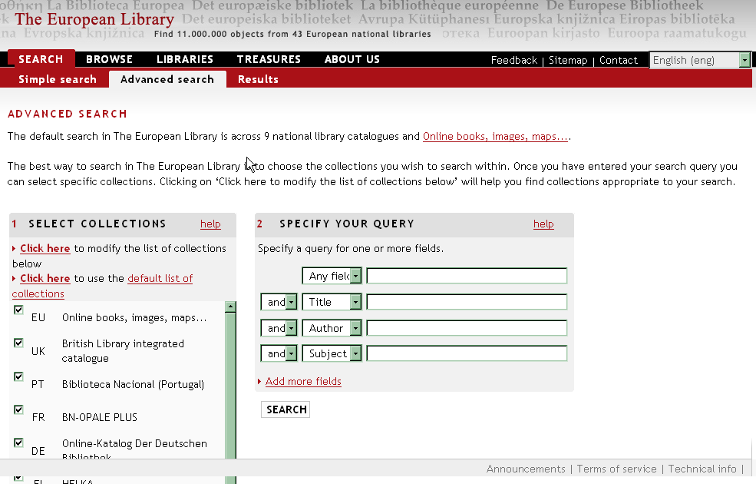
The advanced search provides two functions, the input of a more complex
query and the modification of the databases that are searched
Notes:
The portal includes an advanced search screen
The user can enter a more complex search through a form
And the user can make a selection of the catalogues to be search

Slide 14
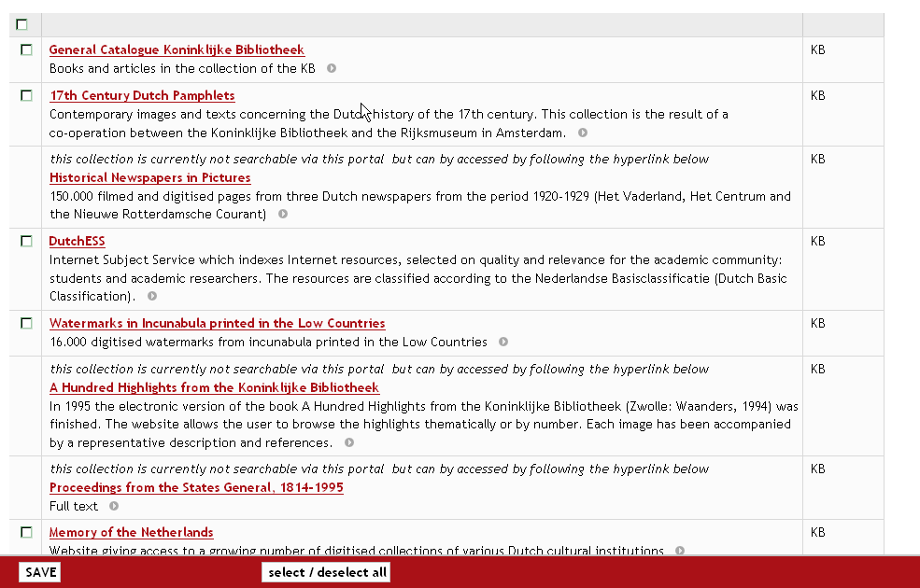
The user can select from a large list of catalogues and databases
Notes:
The portal provides a large list of database which the user can select for the federated search
In this case by clicking on the entry for a particular database.
This part of the system is based on the DC Collection Description profile – and we shall be providing more information about this at ________________________________________
What I have described so far seems not very unusual, but behind this interface lies a novel architecture for a library portal – an architecture based on a Dublin Core Application Profile and a new search and retrieval protocol called SRU.

Slide 15
Standard portal architecture
Local XML format database
SRU database
Z3950 target
Web search
PORTAL
SYSTEM
The normal
architecture
in this type of
application
The
User’s PC
Notes:
The normal architecture for a portal use some type of portal system sitting between the User Interface and the various databases to which the portal provides access.
Usually multiple search interfaces, multiple protocols and multiple record formats to process.
A central server which may provide a bottleneck.

Slide 16
The TEL Architecture
OAI Data
Provider
Z3950 database
http XML database
Local SRU database
Central SRU database
SRU/ Z3950 gateway
SRU/ XML gateway
Common interface using the SRU protocol & Application Profile
SRU URL - query
SRU response - XML
The
User’s PC
XML
Web
Browser
XSL Transform
Javascript
HTML
Functionality
End User Interface
Notes:
The European Library architecture works in a completely different way.
The portal comprises software running in the users PC that access the databases and catalogues directly.
This architecture relies on 2 crucial components :
The use of a common search protocol by all the databases SRU , and the use of a standard metadata form – the TEL AP.
Obviously most of the catalogues and databases of the TEL partners do not conform to these requirements.
This particular issue is overcome by the use of software we call a gateway that sits in front of the legacy application and provides the interface required by the European Library partners.

Slide 17
SYSTEMS DIAGRAM FOR A GATEWAY
SRU URL
for
database A
SRU URL
for
database B
SRU URL
for
database C
Web server, e.g. Apache
Parameters tailor
the gateway script
for each Z39.50
database
Script for
Database A
Script for
Database B
Script for
Database C
Python
Unix, Linux, Windows server
Z39.50
Some other
database using http / XML
Databases at
Z39.50 target
One Z39.50 target,
several databases
Notes:
It might be helpful to look at a gateway in more detail.
A gateway can run on many operating system
In this case we have a set of scripts used in conjunction with a web server such as Apache
The scripts are parameterised and point to particular Z39.50 database.
Gateways can also be created for databases that use some other form of protocol, for example an http XML protocol as used by the Google Search Appliance

Slide 18
Gateway processing
Converts between two protocols – most commonly SRU and Z39.50, but also SRU and http/XML.
In addition, the gateway :
Converts the standard query syntax to a local form.
Converts the character set to Unicode utf-8.
Converts the record format – for example from MARC21, UNIMARC, MARCXML, SUTRS and various XML formats to the application profile.
Adds data, for example OpenURL, rights statements and links to services based on the record content.
Notes:
The advantage of using a gateway is that it allows additional processing of the records from the legacy system into something more useful for the application.
A legacy system can be made compatible with a new system without requiring changes to the legacy system.
Protocol conversion
Record format conversion
More subtle chnages :
Massage the query to tailor it to the legacy system
Change character sets
Add data

Slide 19
The British Library Architecture
Remote Z39.50 databases
Integrated Catalogue
Journal Articles database
Sound Catalogue
BL
Z39.50 databases
TEL Partners
COPAC
XML database
Aleph X Server
BL Web Site Search
Google Search
Remote
httpXML database
PubMed Entrez
Themed Collections
Illuminated MSS
Collect Britain
Remote SRU database
Local SRU database
TEL Partners
Library of Congress
SRU gateway
SRU
Common interface using the SRU protocol & Application Profile
Notes:
Now we can look in more detail at the British Library architecture
The objective is a common interface to a wide set of databases, obviously much will supplied through a gateway
To various Z39.50 services and http XML services, both internal to the BL and Remote.
Some example of services are
themed collections
web site search from the Google Search Appliance
the Integrated Catalogue and other major catalogues such as sound
external databases
Pubmed
and organisations providing SRU interfaces, for example the Library of Congress

Slide 20
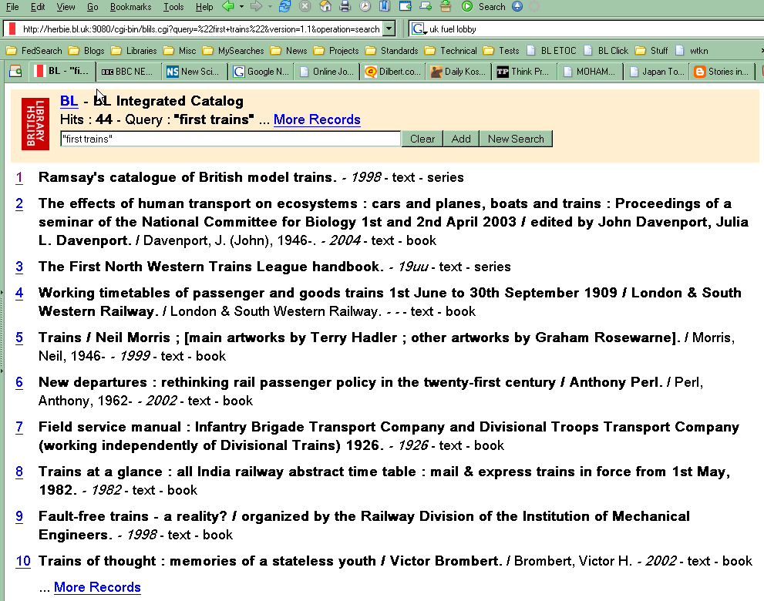
The SRU URL consists of two parts :
The database :
herbie.bl.uk:9080/cgi-bin/blilsX.cgi
The query parameters :
?query = preston
&operation=searchRetrieve
&version=1.1
&recordSchema=blap
A set of brief records returned by a search
Notes:
This is an example of a simple search page for the British Library Integrated Catalogue.
All the catalogues and databases can be accessed using this standard user interface.
This gives me an opportunity to explain SRU in a little more detail.
The SRU URL specifies the search :
the domain name and path define the database
the parameters define the query and other aspects of the search such as the recordSchema
there are more parameters than shown here,
for example the records to be returned with the search result, for example start at record one and send 10 records

Slide 21
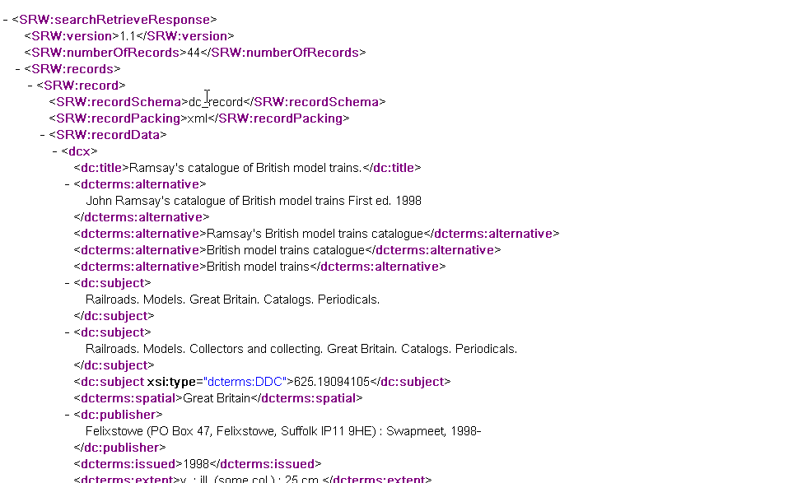
Search Result
The metadata for each record in the Application Profile
Notes:
This is the response provided by the SRU search.
An XML wrapper containing details of the search, for example the number of records found
The selected records in the application profile.
This XML is transformed by an XSLT style sheet to the web page seen by the user.

Slide 22
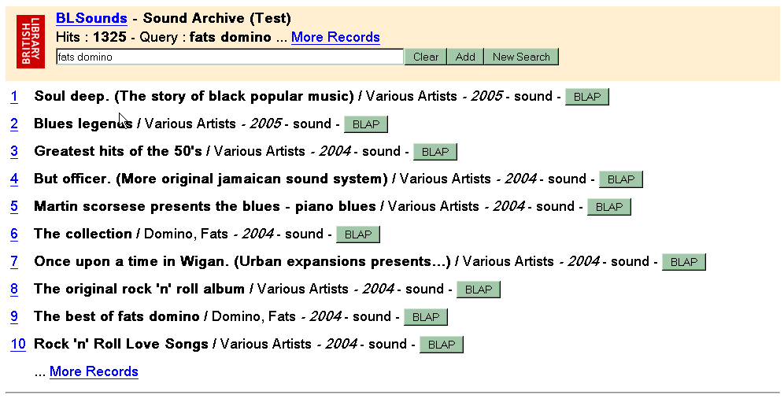
Example search page : Sound Catalogue
Notes:
Here is another example, in this case searching the sound catalogue

Slide 23
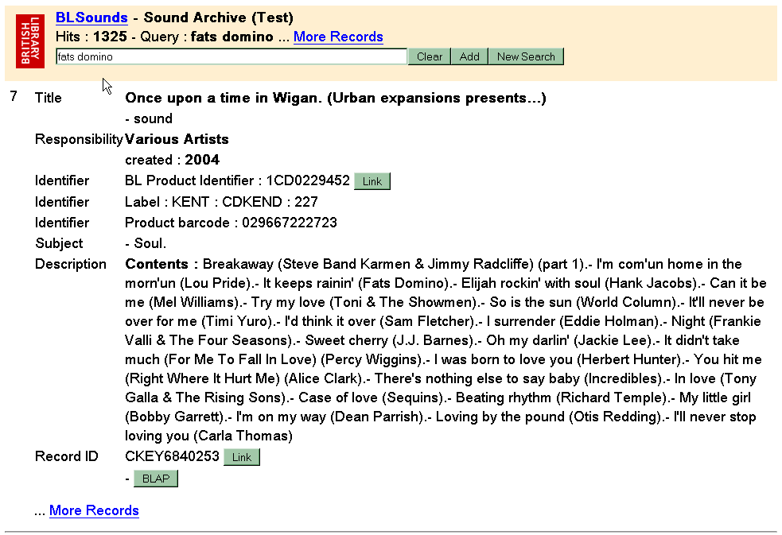
Notes:
A user can move form a brief display to a full display
For the is catalogue the user is able to obtain a BLAP record for this item by simply clicking on the link.

Slide 24
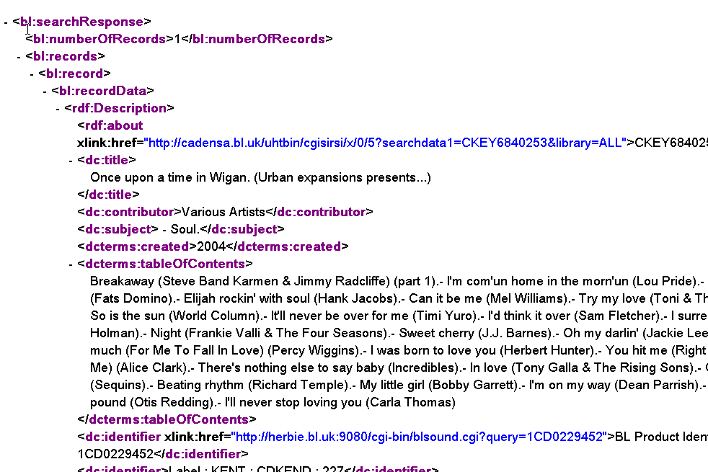
Notes:
The purpose of this is to provide BLAP records which can be used by digitisation projects as a base record.
The user searches for the item being catalogued, extracts the record and copies it into the database.

Slide 25
British Library Global Search
User enters
query on
web page
global search request
Global search cgi script
XML
XML response
processed by
XSLT stylesheet
And CSS page layout
SRU
SRU servers for
BL catalogues and
databases
User views
search
results
Notes:
The last example is the provision for a global, federated search across the main BL catalogues.
Our objective here is to show a user the contents of the Libraries main collections and information sources.
This works in a slightly different way to a portal.
The user enters query
The script responds with a set of SRU queries XML
The processing of the XML downloads records from the catalogues
Then the responses are displayed as a list.
The result being as follows

Slide 26
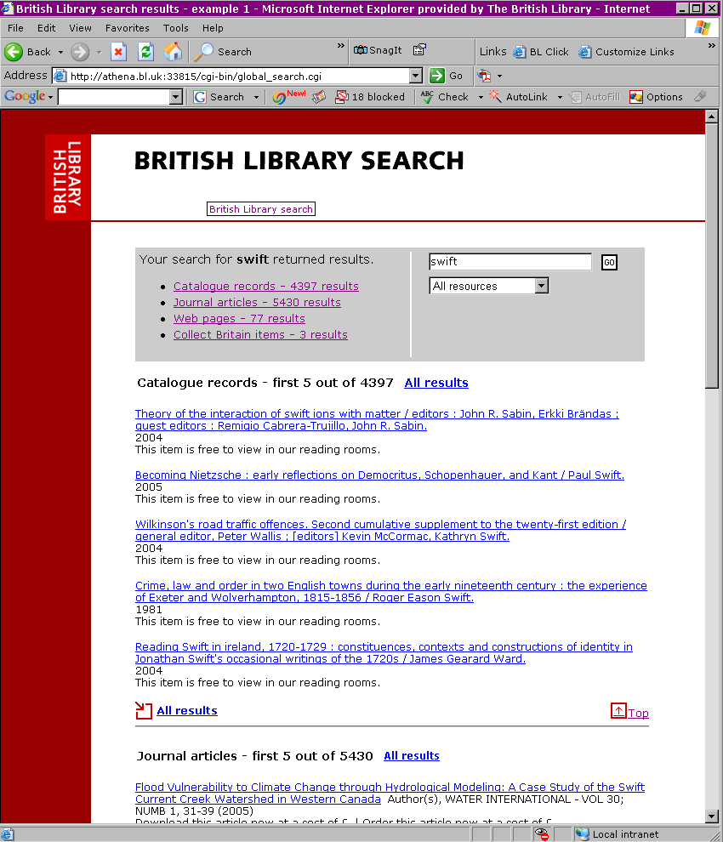
Notes:
This is an experimental prototype of this service
The user arrives at this results page. (The search can be revised at this points)
The user can scroll down …

Slide 27
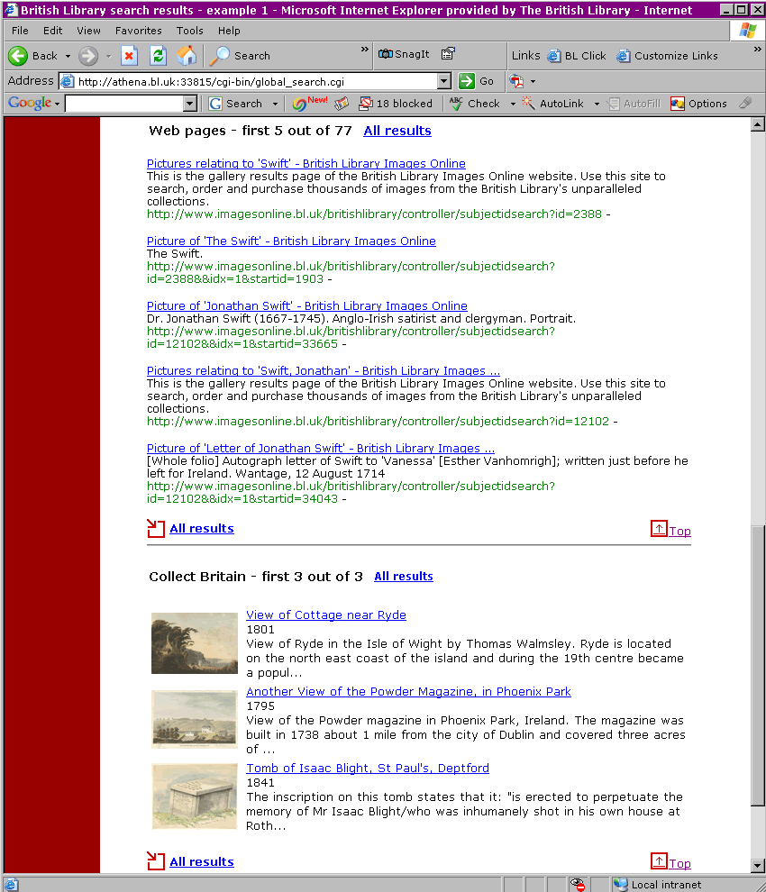
Notes:
To see records from another database, and so on.
Choosing an item of interest by clicking on the link, takes the user into the catalogue for that item.

Slide 28
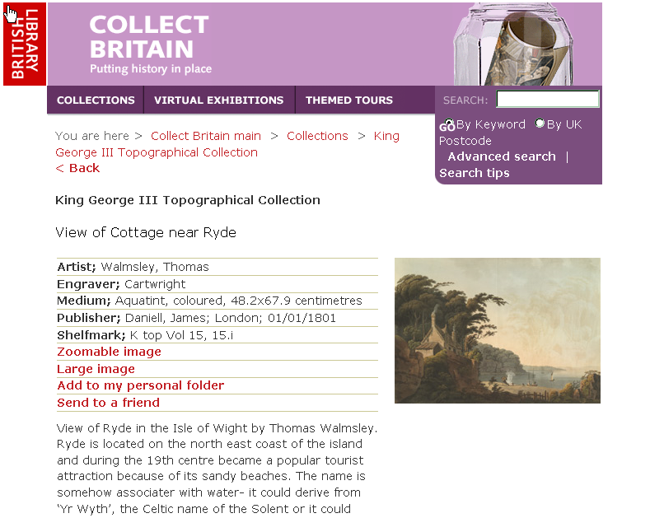
Notes:
For example, this record in Collect Britain
From this point the user can search this collection more extensively.
These examples are early experiments in the use of the BL Application Profile
Live applications will follow.

Slide 29
Conclusions
A single, modern protocol for searching, SRU, and a common Application Profile based on DC important tools for rapid development
Systems can be developed quickly to support new digitisation projects with records using the Application Profile
Federated searches across a wide range of databases is easier to implement
As this is achieved without affecting the legacy systems, there is scope for experimentation
Notes:
At the level of the user interface, the importance of the common search and retrieval protocol and the Application Profile is not necessarily obvious.
SRU was designed to be a modern protocol fitting closely with current technology such as http and XML as a result the functional development of these systems proves a much quicker task than might be possible a more complex architecture of mulitple protocols and different record formats.
The BL has a legacy of many diverse databases and this is coupled with the need to find a realistic solution to metadata creation in on-going digitisation work. The establishment of a generic DC-based application profile opened the possibility of customised but interoperable profiles for projects as well as offering the potential to cross-search other BL datasets. The exploitation of a new SRU protocol to search for and present records, used in conjunction with the profile, has provided the BL with this uniform method of access across its collections. Simple prototype systems demonstrate the advantages of this approach and, because they leave the underlying databases unchanged, allow the experimentation that will lead to more substantial plans for operational services.

Slide 30
The end
Thank you
Notes:
Thank you

